Slide 1
DDOS prevention. Cloudflare

Slide 2
Cloudflare provides unmetered and unlimited distributed denial-of-service (DDoS) protection to all customers on all plans and services.
The protection is enabled by Cloudflare’s Autonomous DDoS Protection Edge, which automatically detects and mitigates DDoS attacks.
The Autonomous Edge includes multiple dynamic mitigation rules exposed as Cloudflare DDoS Attack Protection Managed Rulesets, which provide comprehensive protection against a variety of DDoS attacks across L3/4 and L7 of the OSI model.

Slide 3
How it works
To detect and mitigate DDoS attacks, Cloudflare’s Autonomous Edge and centralized DDoS systems analyze traffic samples “out-of-path”, which allows Cloudflare to asynchronously detect DDoS attacks without causing latency or impacting performance.
The analyzed samples include:
Packet fields such as the source IP, source port, destination IP, destination port, protocol, TCP flags, sequence number, options, and packet rate.
HTTP request metadata such as HTTP headers, user agent, query-string, path, host, HTTP method, HTTP version, TLS cipher version, and request rate.
HTTP response metrics such as error codes returned by customers’ origin servers and their rates.
Once attack traffic matches a rule, Cloudflare’s systems will track that traffic and generate a real-time signature to surgically match against the attack pattern and mitigate the attack without impacting legitimate traffic. The rules are able to generate different signatures based on various properties of the attacks and the signal strength of each attribute. For example, if the attack is distributed — that is, originating from many source IPs — then the source IP field will not serve as a strong indicator, and the rule will not choose the source IP field as part of the attack signature. Once generated, the fingerprint is propagated as a mitigation rule to the most optimal location in the Cloudflare edge for cost-efficient mitigation. These mitigation rules are ephemeral and will expire shortly after the attack has ended, which happens when no additional traffic has been matched to the rule.

Slide 4
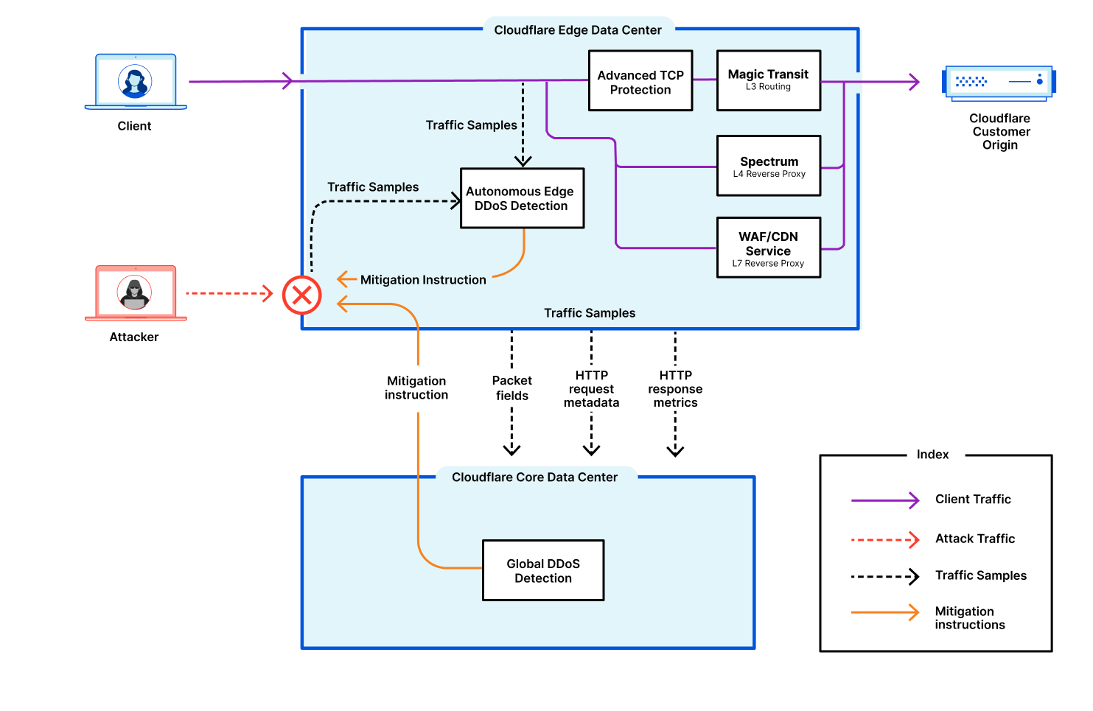
Main components
Autonomous Edge
The Cloudflare Autonomous Edge is powered by the denial-of-service daemon (dosd), which is a home-grown software-defined system. A dosd instance runs in every single server in every one of Cloudflare’s edge data centers around the world. These dosd instances can detect and mitigate DDoS attacks autonomously without requiring centralized consensus. Cloudflare users can configure this system through DDoS Managed Rulesets.
Another component of Cloudflare’s Autonomous Edge includes the Advanced TCP Protection system. This is Cloudflare’s TCP state tracking machine for detecting and mitigating the most randomized and sophisticated TCP-based DDoS attacks in unidirectional routing topologies — such as the case of Magic Transit. Advanced TCP Protection is able to identify the state of a TCP connection and then drops, challenges, or rate-limits packets that do not belong to a legitimate connection.
For more information, refer to our blog post A deep-dive into Cloudflare’s autonomous edge DDoS protection.
Centralized DDoS protection system
Complementary to the Autonomous Edge, Cloudflare’s entire global network is overwatched by a global version of dosd. This component protects Cloudflare’s entire global network by detecting and mitigating globally distributed volumetric DDoS attacks.
The centralized systems run in Cloudflare’s core data centers. They receive samples from every edge data center, analyze them, and automatically send mitigation instructions when detecting an attack. The system is also synchronized to each of our customers’ web servers to identify their health and trigger any required mitigation actions.

